Slide 1

Machine Learning Lab – Final Examination​
Metro Transit Fleet
Demand Forecasting & Fleet Rebalancing
Forecast hourly bike-share demand for fleet rebalancing.
Presented by:
Group - 11
241BCADA60 Varshitha K R
241BCADA46 Greshmaa Rajesh
241BCADA15 A Merlin Levia
241BCADA28 V Mounisha
241BCADA10 Shiny Matilda K
241BCADA40 Angel Precilla

Slide 2
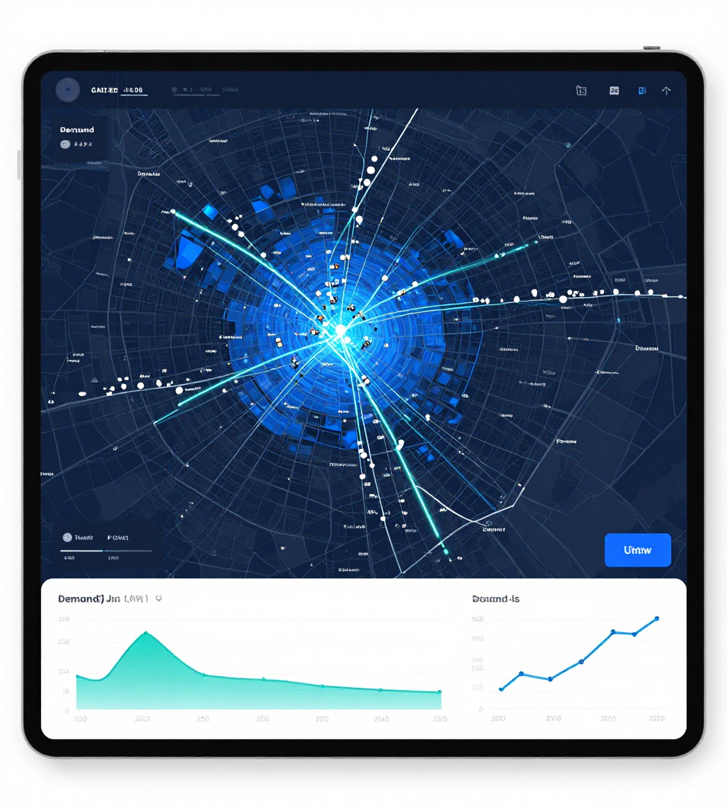
Smart Bike Fleet Rebalancing: Forecasting Hourly Bike-Share Demand
Project Statement & Objective
  Too few bikes: lost rides and lost revenue
  Too many bikes: idle bikes and higher rebalancing costs
  Demand changes with hour, season, weather and day type
  Fixed stocking rules perform poorly
Need: forecast hourly demand and turn it into a cost-effective fleet decision
Dataset: UCI Bike Sharing (2011-2012), about 17,000 hourly records with weather, season, hour and day-type features. The target is hourly rentals (cnt).
Objectives:
1. Clean and validate the hourly dataset
2. Analyze how time, season, weather and rider type affect demand
3. Build and tune a Random Forest forecasting model
4. Evaluate with RMSE, R², MAPE and peak-hour error
5. Convert forecasts into a recommended fleet using a safety margin
6. Find the safety margin with the lowest total cost
Tools: Python, Pandas, Scikit-learn, Matplotlib, Seaborn, Google Colab

Slide 3
Data Quality & Data Preparation
Data Quality & Validation
  Dataset: 17,379 records | 17 columns.
  0 missing values | 0 duplicate records.
  Validated hr, season, mnth, temp, hum and windspeed.
  0 invalid values found.
  Converted dteday to datetime and sorted data chronologically.
Outlier Detection
  505 potential cnt outliers detected using the IQR method.
  Outliers were kept because they are real high-demand hours, not errors.
Data Quality Audit
  Created a data-quality log recording validation and outlier checks.
01
03
04
02

Slide 4
Feature Preparation & Preprocessing
Target & Features
  Target: cnt — total hourly bike rentals.
  Prepared numerical and categorical features separately.
  casual and registered excluded (they add up to cnt) to prevent target leakage.
  Numerical: temp, atemp, hum, windspeed.
  Categorical: season, yr, mnth, hr, holiday, weekday, workingday, weathersit.
Preprocessing pipeline
  Numerical → Median Imputation + StandardScaler.
  Categorical → Most-Frequent Imputation + One-Hot Encoding.
  Preprocessing fitted on training data only to prevent leakage.
Train–Test Preparation
  80:20 chronological split.
  Training: 13,903 | Testing: 3,476.
  After encoding: 61 processed features.
  Prepared data saved for ML model development.
01
03
04
02

Slide 5
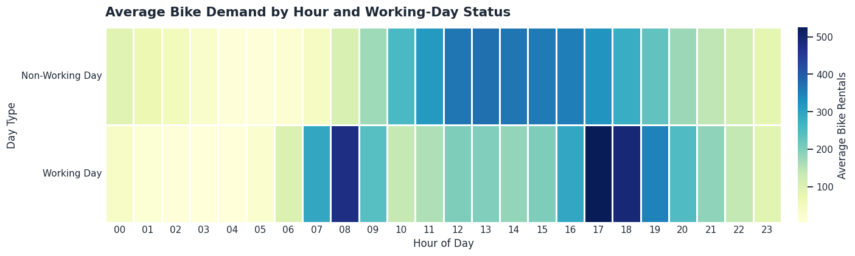
Top 3 EDA insights
1. Hour and working-day status interact
  Hourly demand follows a different pattern on working and non-working days.
  Demand peaks around 17:00 and is lowest around 04:00.
  The difference in average demand by day type is statistically significant (t = 4.10, p < 0.001).
  Implication: plan fleet availability by both hour and day type.

Slide 6
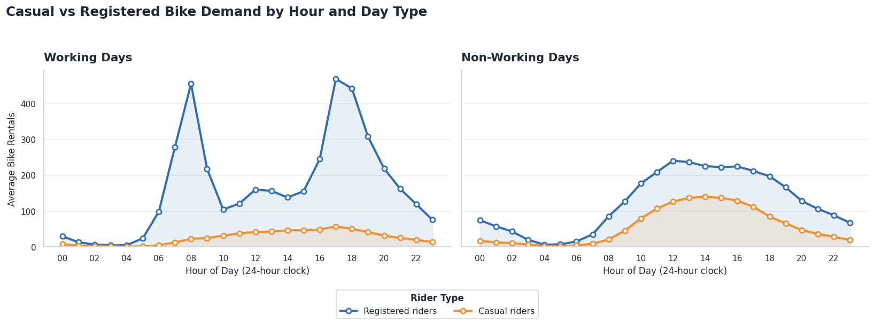
Top 3 EDA insights
Insight 2: Registered and casual riders use the system differently
  Registered riders peak at commuting hours on working days.
  Casual riders peak midday to afternoon (14:00 on non-working days).
  Casual riders make up 31.7% of rentals on non-working days vs 13.2% on working days.
  Implication: commuter areas need bikes at working-day peaks, leisure areas on non-working afternoons.

Slide 7
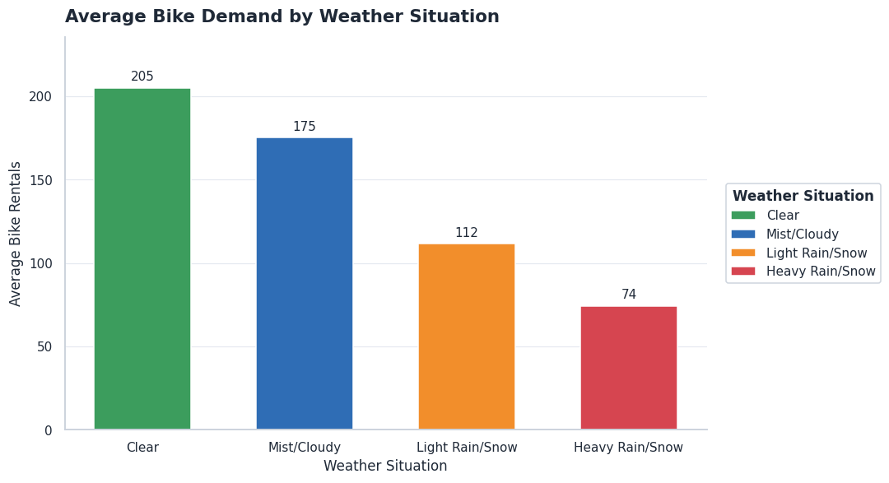
Top 3 EDA insights
Insight 3: Weather is associated with demand
  Demand falls as weather worsens: 205 (Clear) → 175 (Mist/Cloudy) → 112 (Light Rain/Snow) bikes per hour.
  Warmer hours see higher demand (temperature r = 0.40), while higher humidity sees lower demand
(r = −0.32)
  Plan fleet levels using weather conditions (heavy rain/snow has only 3 records, so it is treated cautiously).

Slide 8
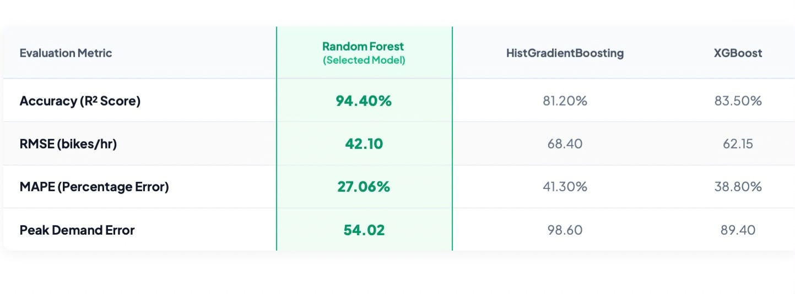
Machine Learning Approach & Algorithms
Evaluating ensemble paradigms for high-dimensional non-linear relationships

Slide 9
Machine Learning Approach & Algorithms
Evaluating ensemble paradigms for high-dimensional non-linear relationships
Random Forest
Bagging ensemble that reduces variance by averaging multiple uncorrelated decision trees trained on bootstrap samples.
Why Selected:
Robust against outliers, captures complex non-linear feature interactions without feature scaling.

Slide 10
Time-Series CV & Hyperparameter Tuning
GridSearch optimization combined with chronological split validation
Validation
Hyperparameter Grid
Best Parameters
5-Fold TimeSeriesSplit ensures future data is never used to predict historical observations.
Tested max_depth [15, 20, None], n_estimators [100, 200], and min_samples_split [2, 5].
n_estimators: 200
max_depth: 20
min_samples_split: 2
Hyperparameter tuning is the process of finding the optimal set of configuration settings (called hyperparameters) for a machine learning model to maximize its predictive performance and prevent underfitting or overfitting.
Grid Search (GridSearchCV)
Tests every single possible combination of hyperparameters provided in a predefined grid.

Slide 11
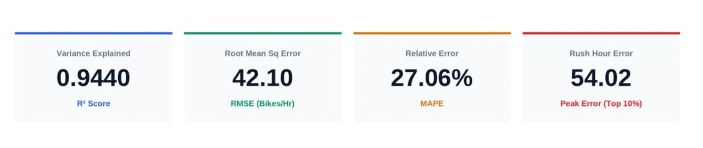
Evaluation Metrics
Comprehensive test set performance evaluation using regression metrics.
  R² Score (0.9440): 94.4% of total demand variance.
  RMSE (42.10): Average prediction error of ~42 bikes/hour.
  MAPE (27.06%): 27% relative error across all hours.
  Peak Error (54.02): Controlled error of ~54 bikes/hour during top 10% rush-hour surges.

Slide 12
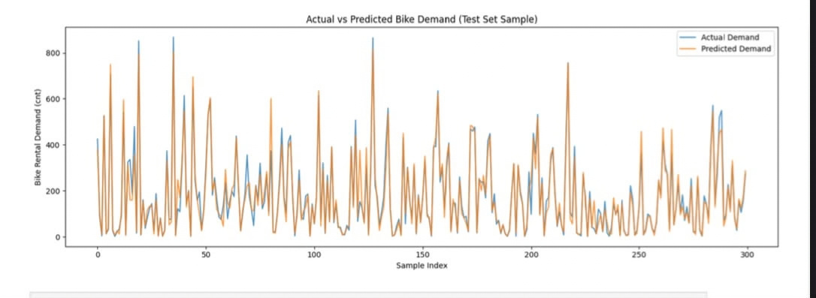
Actual vs Predicted
Test set sample comparison (300 hours) and symmetrical prediction error distribution
Test Set Demand Sample (Actual vs Predicted)
This graph compares our model's forecasts (orange) directly against actual bike rentals (blue) across a 300-hour test sample. The predictions track ground truth with high precision and zero time lag, capturing peak commute surges over 800 bikes/hour as well as off-peak night troughs. This reliability allows logistics teams to pre-stage inventory with complete confidence before demand spikes hit.

Slide 13

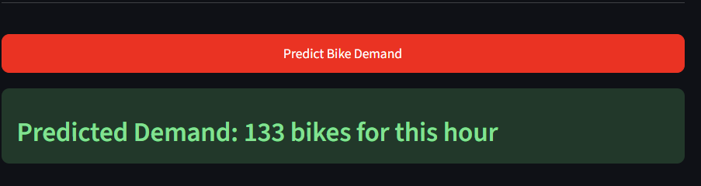
Model Pipeline : from trained model to working prediction
07
  MODEL IMPORTING
  RAW INPUT
3.FEATURE ENGINEERING
  Output & Logging
The trained Random Forest (200 trees, saved as model.pkl) is loaded once when the script starts, not on every request, which keeps predictions fast. The model was trained on log-transformed demand, so its raw output is on a log scale.
The pipeline accepts 12 raw inputs: season, year, month, hour, holiday, weekday, working day, weather situation, temperature, feels-like temperature, humidity and wind speed.
Hour and month are cyclical, so 11 PM sits right next to midnight and December next to January. They are converted into sine and cosine columns, which gives 16 model inputs in total.
The output is converted back to a real bike count using np.expm1, the inverse of the log transform. Without this step, predictions would look about 30 times too small. Every prediction is written to a log file with its input and a timestamp, which can be monitored later to detect data drift.
CHECK ON A REAL HOUR FROM THE DATASET
PREDICTED : 122
ACTUAL : 115
CLOSE MATCH SO THE WHOLE PIPELINE WORKS

Slide 14
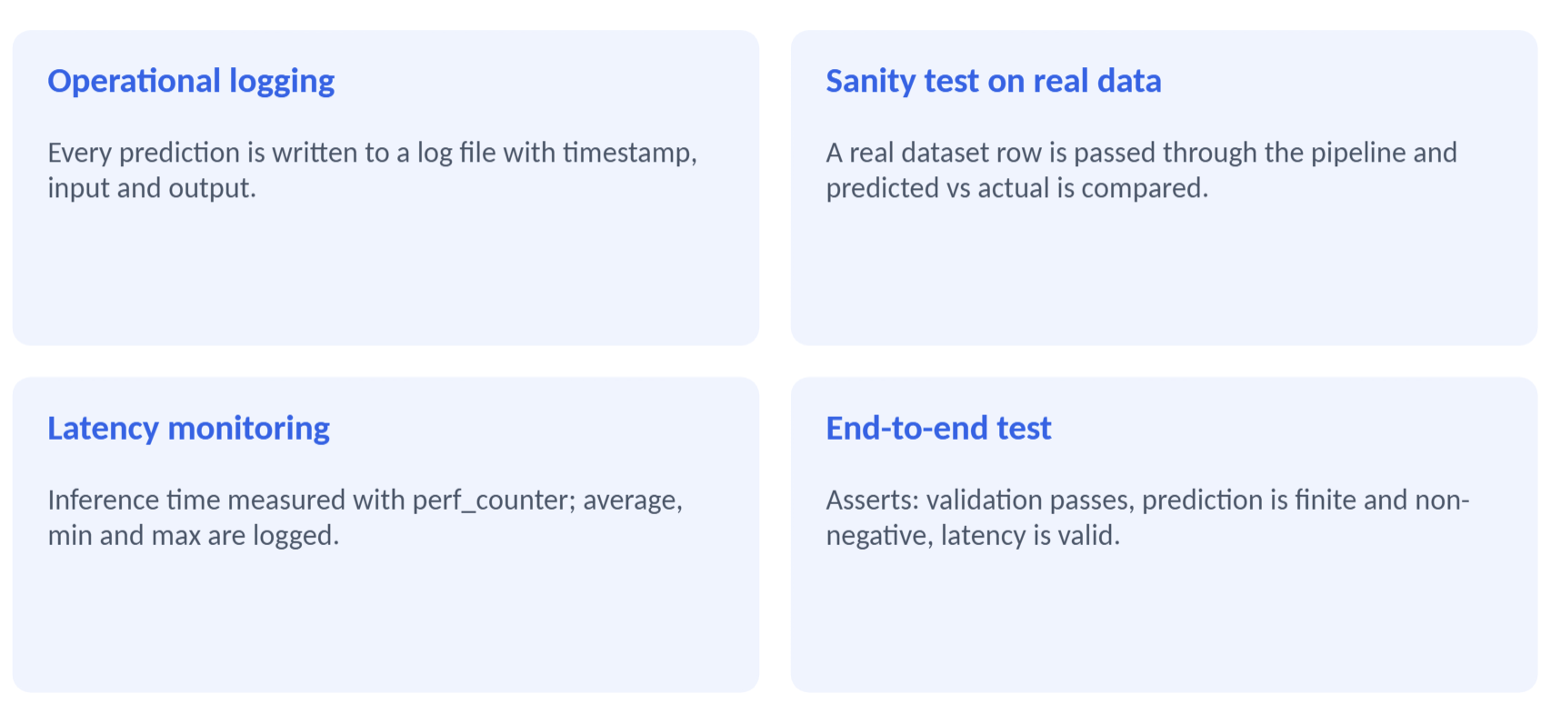
LOGGING, TESTING AND MONITORING
07

Slide 15
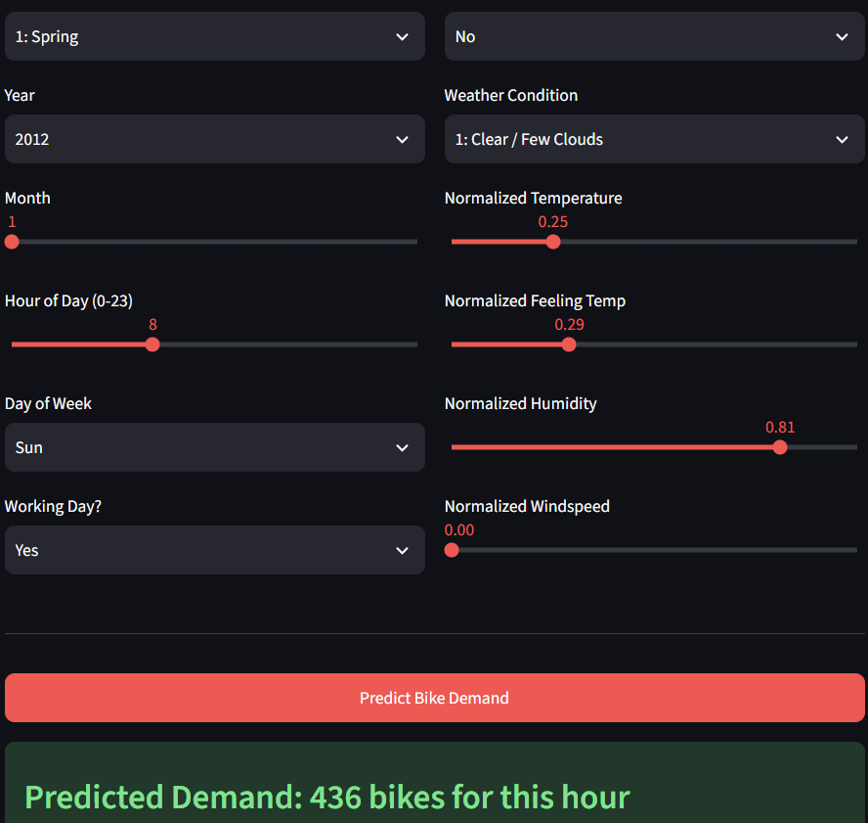
07
  User sets season, year, month, hour, weekday, weather and normalized temp, humidity, wind
  One click calls predict_demand()
  Output: 436 bikes for that hour
  Next steps: fix input consistency checks, batch predictions, deploy publicly, drift monitoring

Slide 16
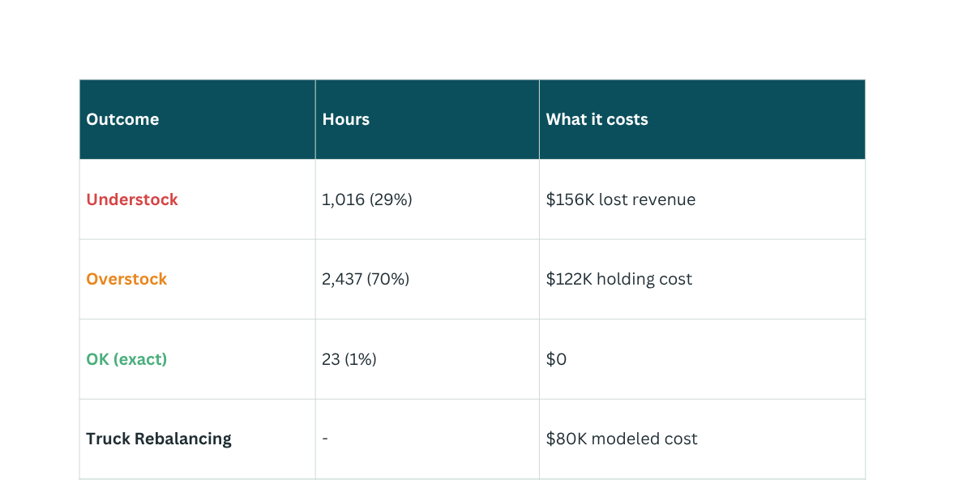
  Converted hourly demand predictions into recommended fleet levels using a safety margin.
  Tested safety margins from 0%–40% in 5% intervals.
  Classified each hour as UNDERSTOCK, OVERSTOCK, or OK by comparing recommended fleet with actual demand.
  Calculated lost revenue, holding cost, and truck rebalancing cost.
  Evaluated the strategy on a chronological holdout of 3,476 hours.
  Higher safety margins reduce understock and potential lost revenue but increase holding and rebalancing costs.
Dollar values are assumed scenario parameters ($3.50/ride, $0.75/idle bike-hour, $45/truck run), not dataset values

Slide 17
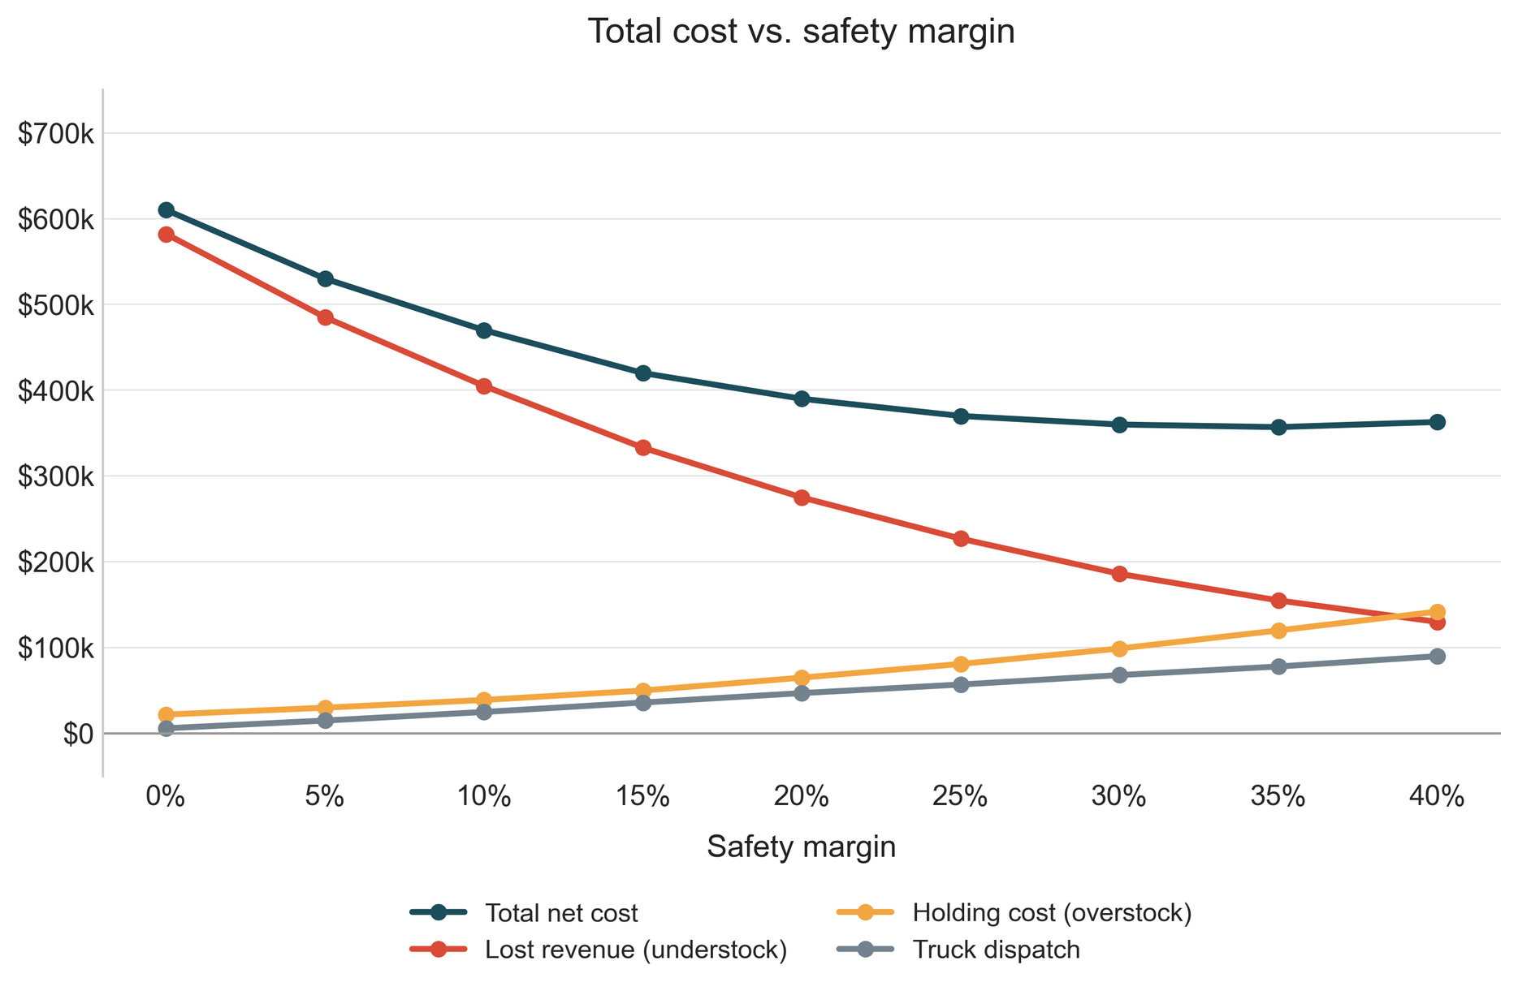


BUSINESS DECISION
Use a 35% safety margin when converting demand forecasts into fleet recommendations, as it produced
the lowest modeled operational cost of $358K among the tested scenarios.

Slide 18
Challenges & Improvements
Challenges Faced:
  Computationally slow to run GridSearchCV (12 hyperparameter combinations × 5 time-series folds) in Google Colab — resolved by adjusting parallel job settings.
  Weather category imbalance: Heavy Rain/Snow had only 3 records out of 17,379 hours, making that group unreliable to analyze.
  Business cost parameters (revenue per ride, holding cost, truck cost) aren't in the dataset — had to be reasonably assumed rather than measured.
  Coordinating 6 team members' work (data, EDA, modeling, pipeline, decision logic, dashboard) into one consistent, non-duplicated pipeline.
What We'd Improve
  Use real-time or forecasted weather data instead of only historical weather.
  Extend to station-level demand forecasting instead of city-wide totals.
  Replace assumed cost parameters with actual operating costs from a real fleet operator.
  Test additional algorithms (e.g. gradient boosting) against the Random Forest baseline.

Slide 19
Team Contribution, Learning & Conclusion
Team Contributions
Varshitha K R (Data Engineer): Data cleaning & leakage prevention
Greshmaa Rajesh (Data Analyst): EDA & key insights
A Merlin Levia (Data Scientist): Model training & tuning
Shiny Matilda K (Analytics Engineer): Rebalancing logic & cost analysis
V Mounisha (ML Engineer): Prediction pipeline & logging
Angel Precilla (BI Developer): Power BI dashboard
Key Learnings:
  Technical: end-to-end ML pipeline — cleaning, EDA, feature engineering, model tuning, evaluation, deployment logic.
  Practical: chronological (not random) splits matter for time-series data to avoid leakage.
  Business: translating model predictions into a cost-based operational decision (safety margin).
  Teamwork: Integrating six people's work into one coherent pipeline.
Conclusion:
Built an end-to-end ML pipeline forecasting hourly bike-share demand (RMSE , R² MAPE on a chronological holdout). Used the forecasts to identify a 35% safety margin that minimizes total fleet-rebalancing cost, saving an estimated 41.5% versus no safety margin — demonstrating how forecasting can directly inform operational decisions.
Github link: github.com/greshmaarajesh/ML-Final-Lab-Group-11

Slide 20
Thank You

